Slide 1


ReactJS I (Introduction to React)

Slide 2
Objective
MVC
Introduces ReactJS (a JavaScript library for building user interfaces)
Setting up your environment
Creating React Elements using JSX.

Slide 3
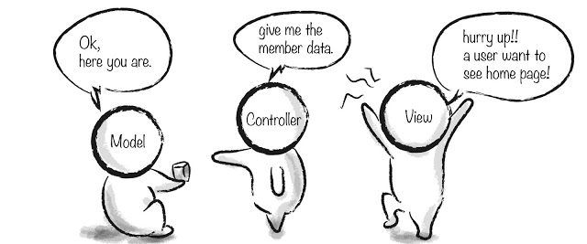
MVC architecture
The Model-View-Controller (MVC) is an architectural pattern that separates an application into three main logical components: the model, the view, and the controller. Each of these components are built to handle specific development aspects of an application. MVC is one of the most frequently used industry-standard web development framework to create scalable and extensible projects.

Slide 4
MVC architecture
Model
It is known as the lowest level which means it is responsible for maintaining data. Handle data logically so it basically deals with data. The model is actually connected to the database so anything you do with data. Adding or retrieving data is done in the model component. It responds to the controller requests because the controller never talks to the database by itself. The model talks to the database back and forth and then it gives the needed data to the controller. Note: the model never communicated with the view directly.
View
Data representation is done by the view component. It actually generates UI or user interface for the user. So at web applications when you think of the view component just think the Html/CSS part. Views are created by the data which is collected by the model component but these data aren’t taken directly but through the controller, so the view only speaks to the controller.
Controller
It’s known as the main man because the controller is the component that enables the interconnection between the views and the model so it acts as an intermediary. The controller doesn’t have to worry about handling data logic, it just tells the model what to do. After receiving data from the model it processes it and then it takes all that information it sends it to the view and explains how to represent to the user. Note: Views and models can not talk directly.

Slide 5
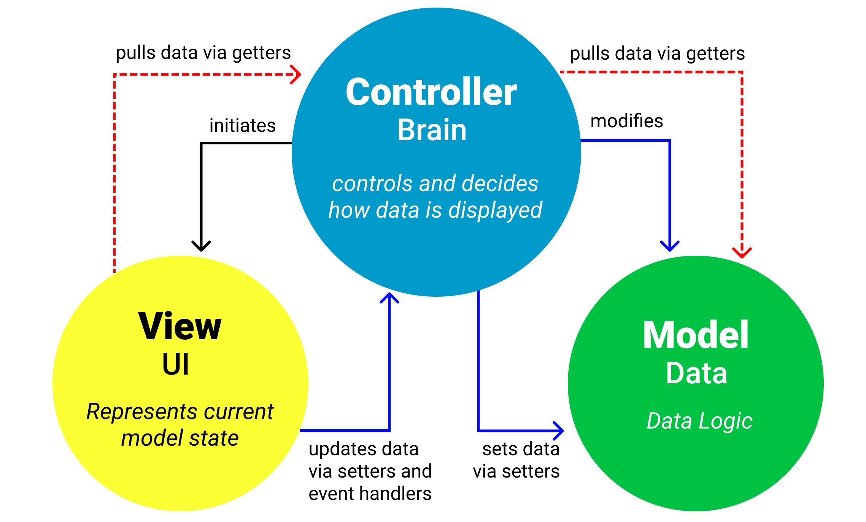
MVC architecture

Slide 6

What is React?
React is a JavaScript library used to generate user interfaces (UIs) that is used for building user interfaces specifically for single-page applications. It’s used for handling the view layer for web and mobile apps. React also allows us to create reusable UI components.
React allows developers to create large web applications that can change data, without reloading the page. The main purpose of React is to be fast, scalable, and simple. It works only on user interfaces in the application. This corresponds to the view in the MVC template.
JavaScript can be used to make web pages dynamic. This is where React comes in. With React, we use JavaScript to write HTML.
React is declarative. This means we tell React what we want to do, not how to do it.

Slide 7
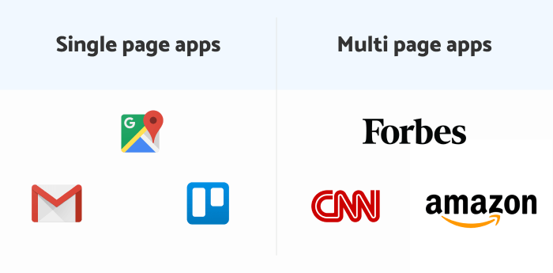


What Is a Single Page Application? (SPA)
Applications that are contained within one web page are called single-page applications (SPA).
The browser downloads the entire app data when you visit SPA web applications. Thus, you can browse through different parts of the app seamlessly and the page won’t reload every time you click on something.
This is because a single page application executes the logic in the browser, instead of a server. It does so with JavaScript frameworks that can lift this heavy data on the client-side. JavaScript also enables an SPA to reload only those parts of the app that a user requests for, not the entire app. As a result, SPAs are known to deliver fast and efficient performance.

Slide 8
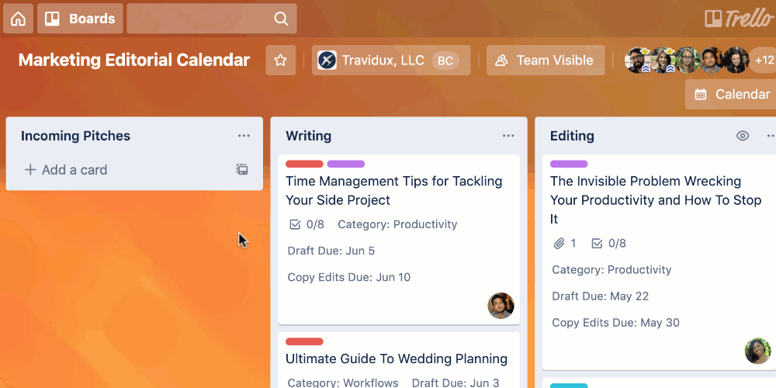
What Is a Single Page Application? (SPA)

Slide 9

Advantages of Single-Page Applications

Slide 10
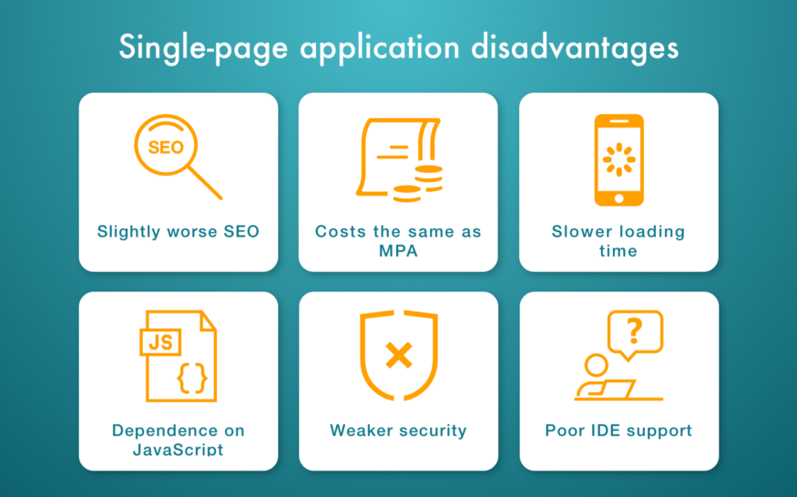
Disadvantages of Single-Page Applications

Slide 11
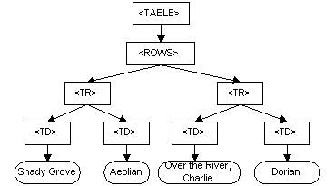
DOM for an HTML Table
Notes:
The image below, from the World Wide Web Consortium, visualises a Document Object Model (DOM) for an HTML table. As you already know, the DOM is a programming API for HTML and XML documents that defines the logical structure of documents and the way they are accessed and manipulated.
As web developers, we use the DOM to manipulate HTML documents. We can add, delete or change HTML elements using the DOM. You have already been doing this using JavaScript. However, rewriting the DOM every time the HTML document changes can slow down your web app significantly. React uses a virtual DOM to address this problem. A virtual DOM is a virtual representation of the HTML document in memory. React works by taking a ‘snapshot’ of the DOM before changes are made. As changes are made, the virtual DOM is updated. After the changes, the virtual DOM and the snapshot of the DOM before the changes (also saved in memory) are compared to see where the changes are. Instead of rewriting the entire DOM, the real DOM is then updated with only the changes that were made.

Slide 12
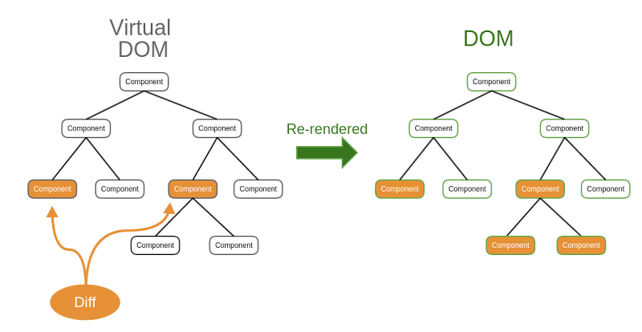
Virtual DOM
Virtual DOM: representation of the HTML document in memory.
React works by taking a ‘snapshot’ of the DOM before changes are made and, as changes are made, the virtual DOM is updated by making those changes.

Slide 13
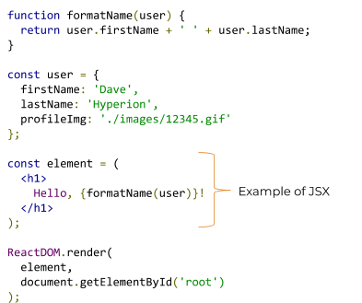
JSX
JSX is a syntax extension for JavaScript that can make creating React applications a lot quicker and easier.
JSX stands for JavaScript XML.
JSX allows us to write HTML in React.
JSX makes it easier to write and add HTML in React.
JSX allows us to write HTML elements in JavaScript and place them in the DOM without any createElement() and/or appendChild() methods.
JSX converts HTML tags into react elements.
Notes:
Like XML, JSX tags have a tag name, attributes and children. With JSX, if an attribute value is enclosed in quotes, it is a string and if the value is wrapped in braces ( { } ), it is an enclosed JavaScript expression.
Babel is a tool that can be used to convert JSX to JavaScript. Go to the Babel REPL website and copy and paste the code above into the ‘Write code here’ space provided so that you can see the difference between this React code (using JSX) and code written using just JavaScript.

Slide 14
JSX
JSX is a syntax extension for JavaScript that can make creating React applications a lot quicker and easier.
JSX stands for JavaScript XML.
JSX allows us to write HTML in React.
JSX makes it easier to write and add HTML in React.
JSX allows us to write HTML elements in JavaScript and place them in the DOM without any createElement() and/or appendChild() methods.
JSX converts HTML tags into react elements.
Notes:
Like XML, JSX tags have a tag name, attributes and children. With JSX, if an attribute value is enclosed in quotes, it is a string and if the value is wrapped in braces ( { } ), it is an enclosed JavaScript expression.
Babel is a tool that can be used to convert JSX to JavaScript. Go to the Babel REPL website and copy and paste the code above into the ‘Write code here’ space provided so that you can see the difference between this React code (using JSX) and code written using just JavaScript.

Slide 15
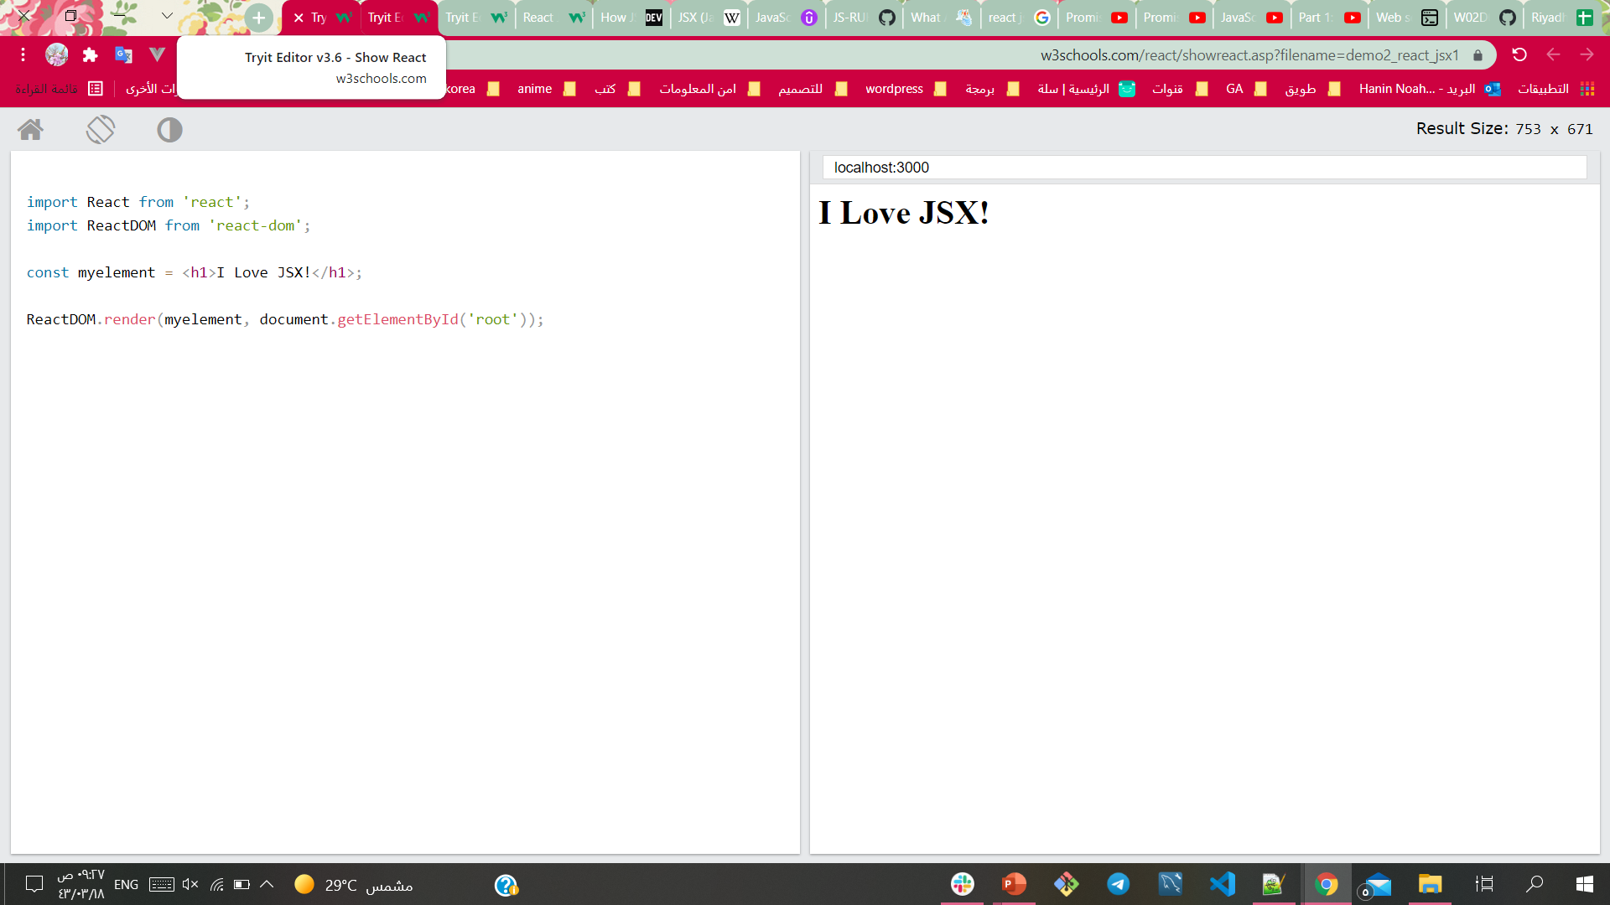
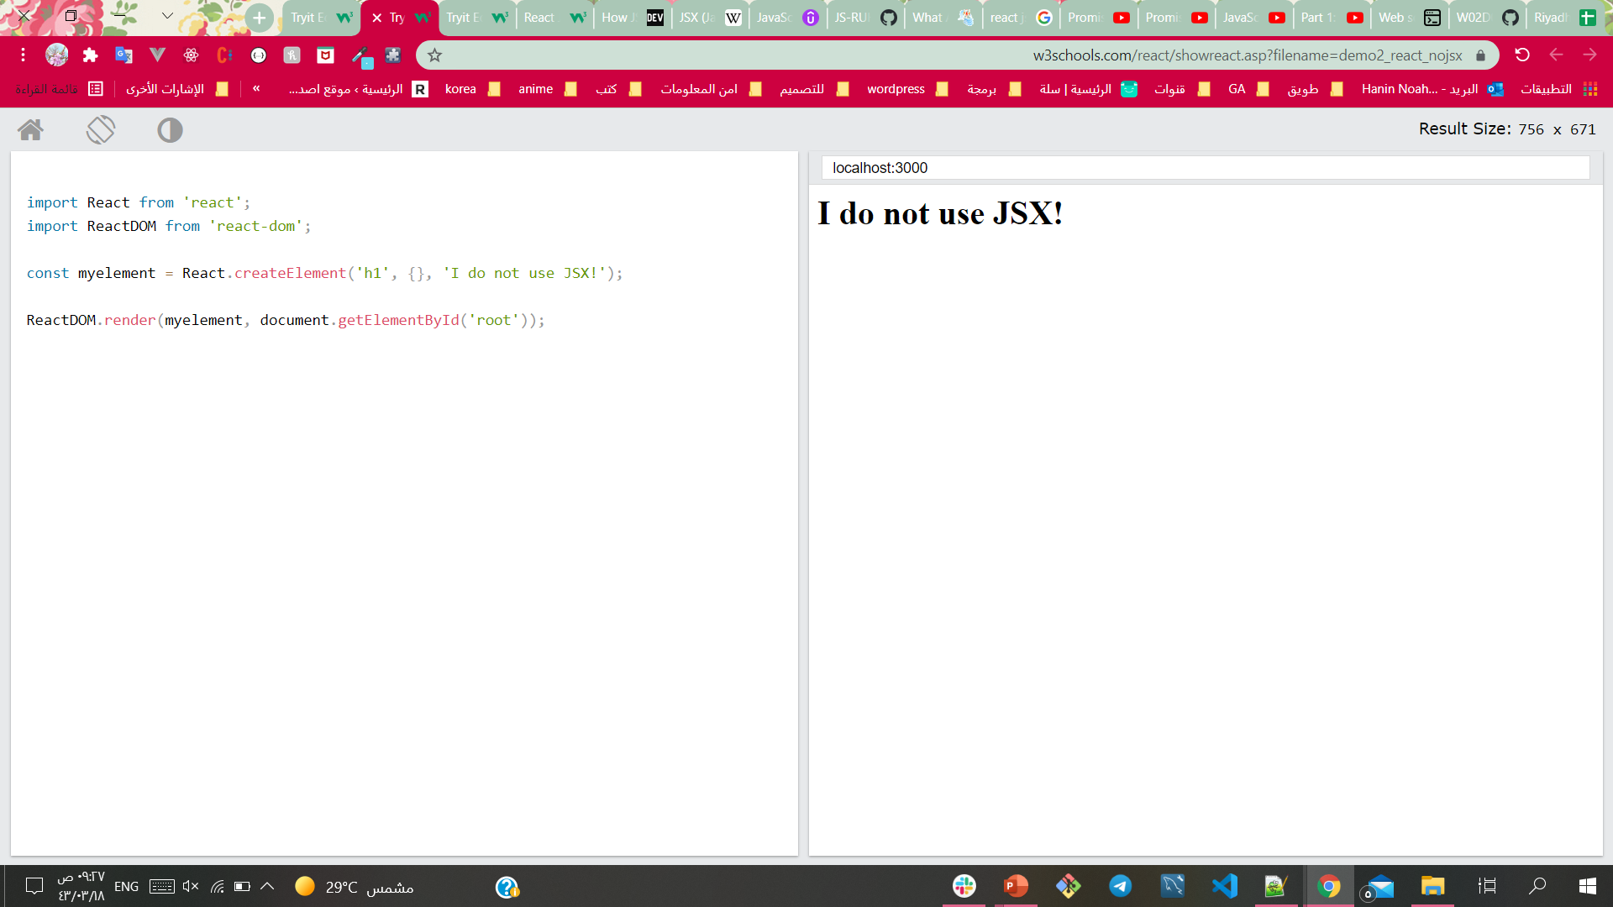
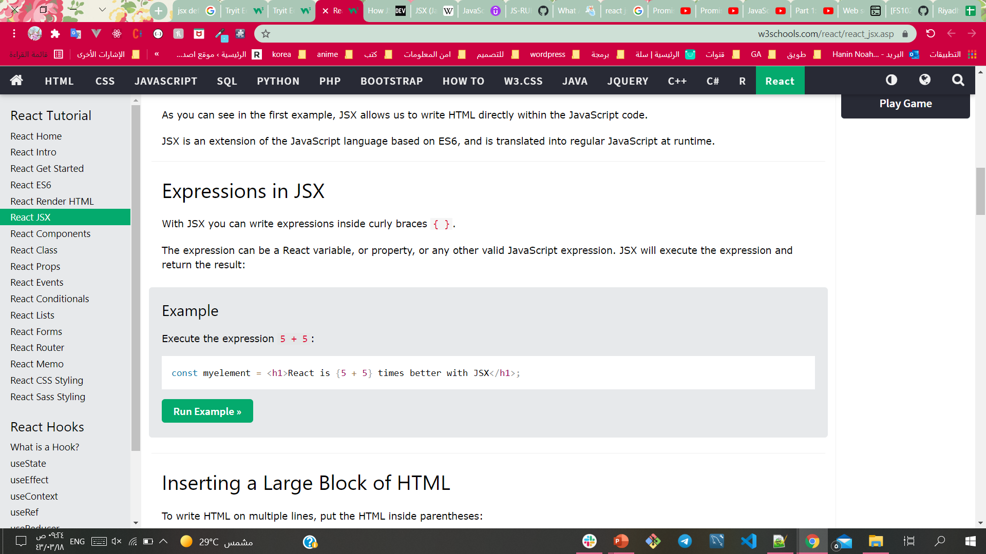
JSX Rules
Here are two examples. The first uses JSX and the second does not:
You can specify various elements that can have different attributes.
You can use normal HTML elements and create user-specified elements.
If an attribute value is enclosed in quotes, it is a string. If it is in braces, it is an enclosed JavaScript expression.
Execute the expression 5 + 5:

Slide 16
JSX Rules
Attributes can be assigned using either:
String literals e.g. <img src=“./images/logo.gif” />
String literals should be enclosed by quotation marks, e.g. “./images/logo.gif”
Or JavaScript expressions, e.g. <img src={user.profileImg} />
JavaScript expressions should always be enclosed by curly braces instead of quotation marks, e.g. {user.profileImg}

Slide 17
React Elements
Elements are the smallest building blocks of React apps. An element specifies what should be there in our UI. An Element is a plain object describing what we want to appear in terms of the DOM nodes.
Official definition:
React elements are the building blocks of React applications. An element describes what you want to see on the screen. React elements are immutable (they cannot be modified after they are created).
const element = <h1>Hello, world</h1>;
Typically, elements are not used directly, but get returned from components.

Slide 18
Creating React Elements
3 Steps to create any React elements:
Create React and ReactDom objects by importing React and ReactDOM.
import React from "react"; import ReactDOM from "react-dom";

Slide 19
Creating React Elements
2. Create the React Element using either JavaScript or JSX.
You could declare a variable that stores HTML or JSX
Your variable could consist of more than one element if you wrap them in a parent element and enclose the elements with ()
const element = (
<div> <h1>I'm learning React with Hyperion</h1> <img src="http://hyperiondev.com/static/moocadmin/assets/img/hyperionLogo.png"/> </div>
); ReactDOM.render(element, document.getElementById('root'));
Notes:
Note: Each element can only return one parent element. However, that element can contain many child elements.

Slide 20
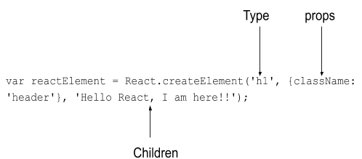
Creating React Elements
c. You could use the createElement() method to create React elements.
const reactElement = React.createElement('h1', {}, 'Hello World!');
ReactDOM.render(reactElement, document.getElementById('root'));
Notes:
The createElement() method takes three arguments:
Type: this could be an HTML tag name (such as ‘div’ or ‘h1’) or a ReactClass (which you will learn more about later). It describes what type of element you are creating.
Props: props are properties that can be passed from parent to child elements. Props that can be passed include descriptions of HTML attributes (like class or style).
Children: used to pass the child elements that this element should have. This could be a string, another React Element or even an array of elements.

Slide 21
Creating React Elements
3. Render the element that you have created to the DOM using the render() method. Once you have created an element, you still have to render it so that it is visible to the user.
ReactDOM.render(reactElement, document.getElementById('root'));

Slide 22
Styling React Elements
As with creating HTML pages, you can create your own custom stylesheets.
To apply the rules in the stylesheet to the elements, simply import the .css file to the JavaScript file where you are creating the element. E.g. import './css/custom.css';
There are several CSS libraries that can make creating components quicker and easier by reusing and modifying existing code, e.g. React-Bootstrap and Reactstrap
Reactstrap: fewer features. A good choice for projects that need smaller builds.

Slide 23

React-Bootstrap
React-Bootstrap is a complete re-implementation of the Bootstrap components using React. To use:
Install using NPM. Navigate to the project directory and type: npm install react-bootstrap bootstrap
Import the React-Bootstrap component you want to use. E.g. import Button from 'react-bootstrap/Button';
Include the latest styles from the React-Bootstrap CDN. Get the link from the official React-Bootstrap
Notes:
Import the React-Bootstrap component you want to use. E.g. if you want to use the React-Bootstrap Button component you would need to add the following line of code: import Button from 'react-bootstrap/Button';

Slide 24

React Starter Kits
React relies heavily on other libraries to work.
Babel is a JavaScript compiler used for writing next generation JavaScript.
It is particularly relevant to developers who work with React because it can convert JSX syntax.
Babel is a toolchain that is mainly used to convert ECMAScript 2015+ code into a backwards compatible version of JavaScript in current and older browsers or environments. Here are the main things Babel can do for you:
// Babel Input: ES2015 arrow function [1, 2, 3].map(n => n + 1);
// Babel Output: ES5 equivalent [1, 2, 3].map(function(n) { return n + 1; });

Slide 25
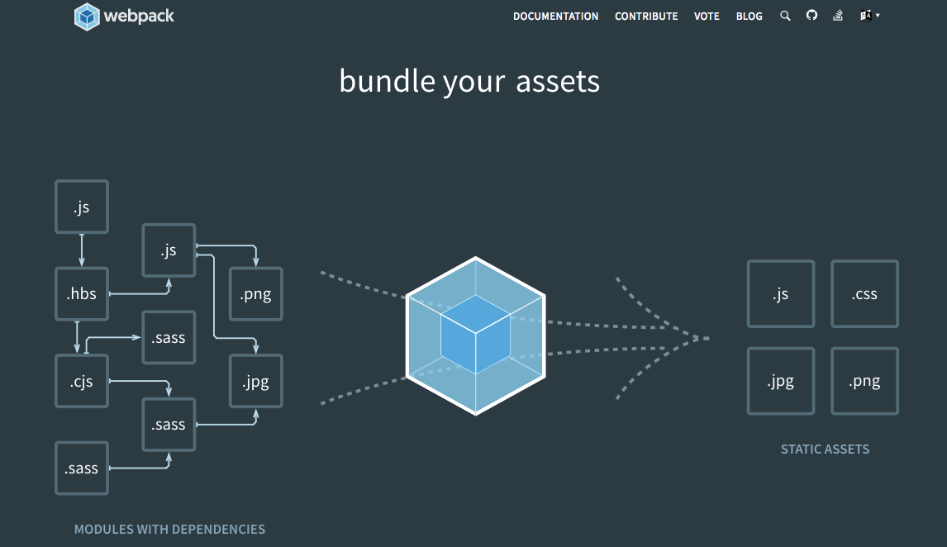
React Starter Kits
React also works best when used with Webpack.
Webpack is a module bundler.
It creates a dependency graph that is used to handle all the resources you need for your app.

Slide 26
React Starter Kits
You could manually install and configure React and all its dependent libraries separately but Facebook, the creators of React, recommend that you use a starter kit instead.
We will use Create React App to create single-page applications and (later in this level) Next.js for creating static and server-rendered applications.

Slide 27
Debugging a React App
The developers of React have created various tools to assist with debugging React apps. To access these debugging tools see here (https://reactjs.org/community/debugging-tools.html).
You can also use CodeSandBox for simple debugging.
It is also important to configure your editor for React development.

Slide 28



Resources
https://www.thirdrocktechkno.com/blog/single-page-apps-vs-multi-page-apps-what-to-choose-for-web-development/
https://www.c-sharpcorner.com/article/what-and-why-reactjs/
https://andrewly.medium.com/pros-and-cons-between-single-page-and-multi-page-apps-8f4b26acd9c9
https://www.freecodecamp.org/news/the-model-view-controller-pattern-mvc-architecture-and-frameworks-explained/
https://towardsdatascience.com/everything-you-need-to-know-about-mvc-architecture-3c827930b4c1
https://www.w3schools.com/react/react_jsx.asp

